Slide 1
Programando con B4X
Tema 5 – Diseñador
Anywhere Software
marzo 2021

Slide 2
Hoy aprenderás
Hablar sobre el diseñador
Diseñar la primera pantalla.
Insertar y personalizar vistas: etiquetas, campos de texto, botones, paneles
Guardar formularios
Diseñar tu propia pantalla principal utilizando esquemas

Slide 3
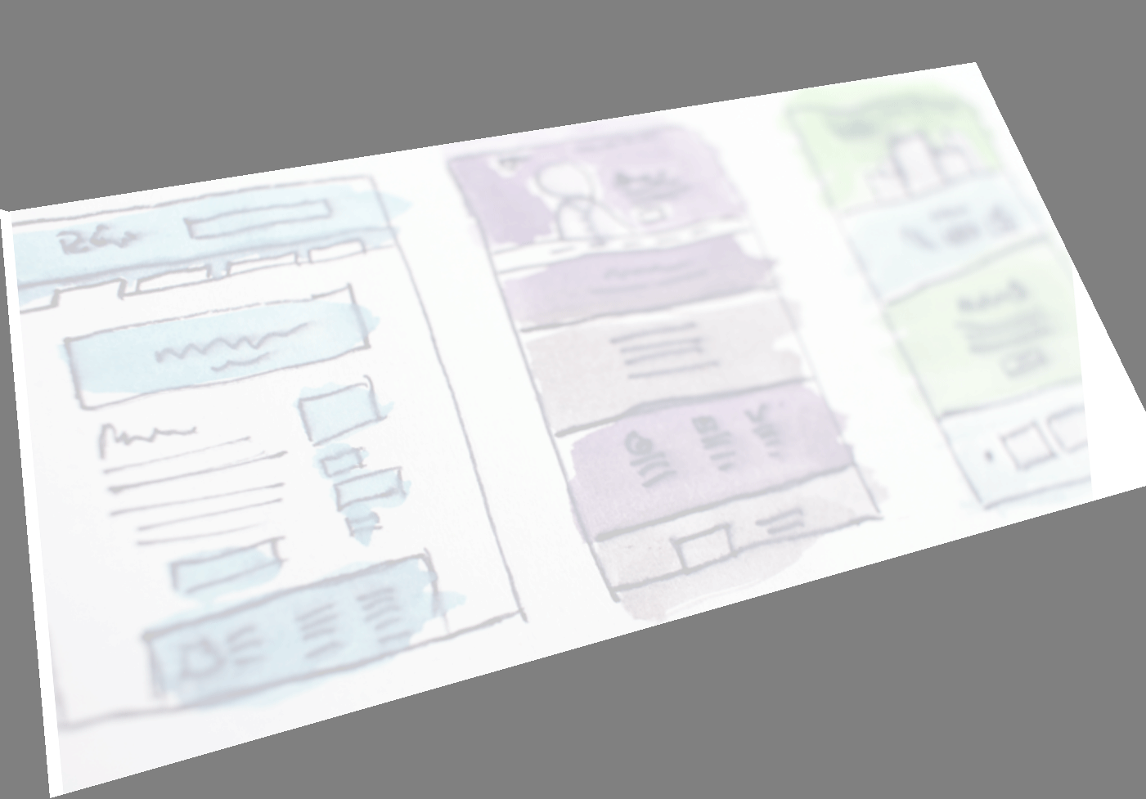
Design elements
Keep the interface simple.
Create consistency and use common UI elements.
Strategically use color and texture.
Use typography to create hierarchy and clarity.
Make sure that the system communicates what’s happening.
Think about the defaults.
Notes:
Keep the interface simple. The best interfaces are almost invisible to the user. They avoid unnecessary elements and are clear in the language they use on labels and in messaging.
Create consistency and use common UI elements. By using common elements in your UI, users feel more comfortable and can get things done more quickly.
Strategically use color and texture. You can direct attention toward or redirect attention away from items using color, light, contrast, and texture to your advantage.
Use typography to create hierarchy and clarity. Carefully consider how you use typeface. Different sizes, fonts, and arrangement of the text to help increase scanability, legibility and readability.
Make sure that the system communicates what’s happening. Always inform your users of location, actions, changes in state, or errors.
Think about the defaults. By carefully thinking about and anticipating the goals people bring to your site, you can create defaults that reduce the burden on the user. This becomes particularly important when it comes to form design where you might have an opportunity to have some fields pre-chosen or filled out.

Slide 4
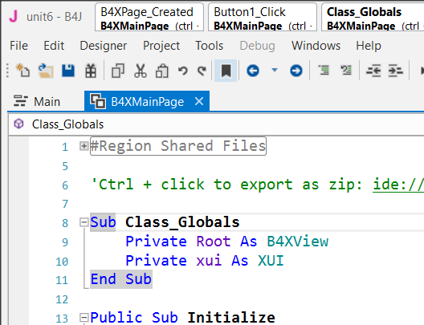
First steps with design
From file menu choose New and B4XPages.
Choose a directory and write a name for your project. You will see the code.
There are two tabs of code here, the first one called Main and the second B4XMainPage.
Now from the Designer menu select Open Internal Designer

Slide 5
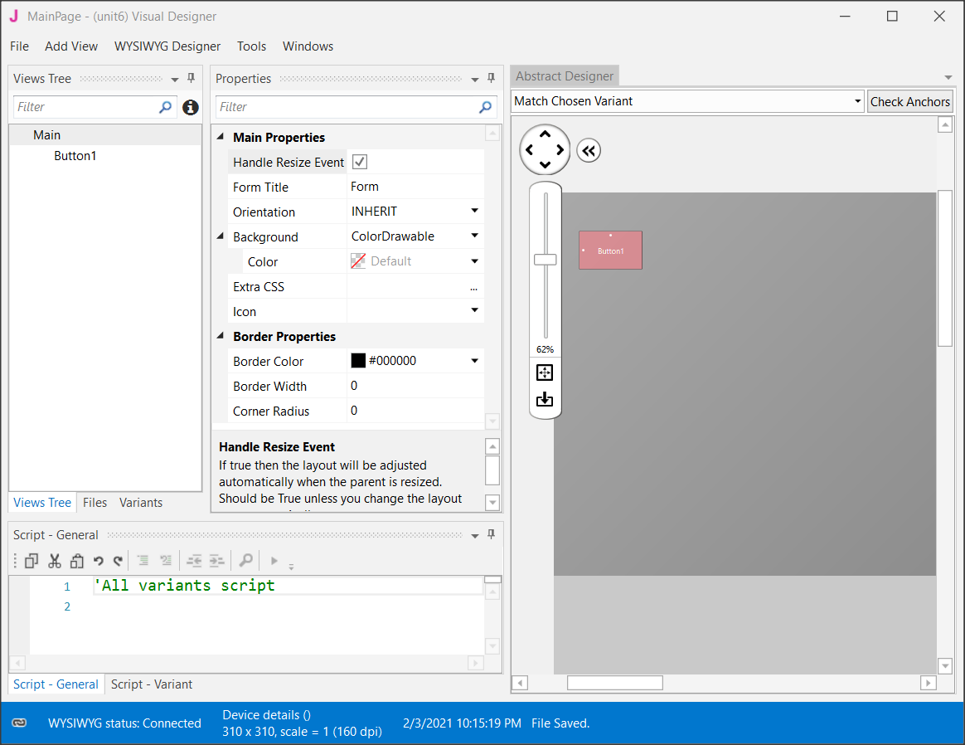
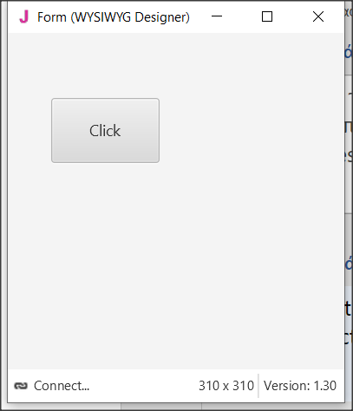
Visual designer
Notes:
This is where the design process begins. Two windows will open, the first is the designer and the second is the preview of the screen you are designing.

Slide 6
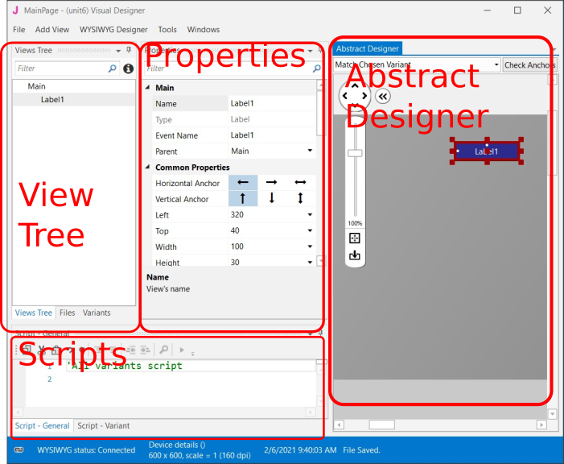
Designer’s Parts

Slide 7
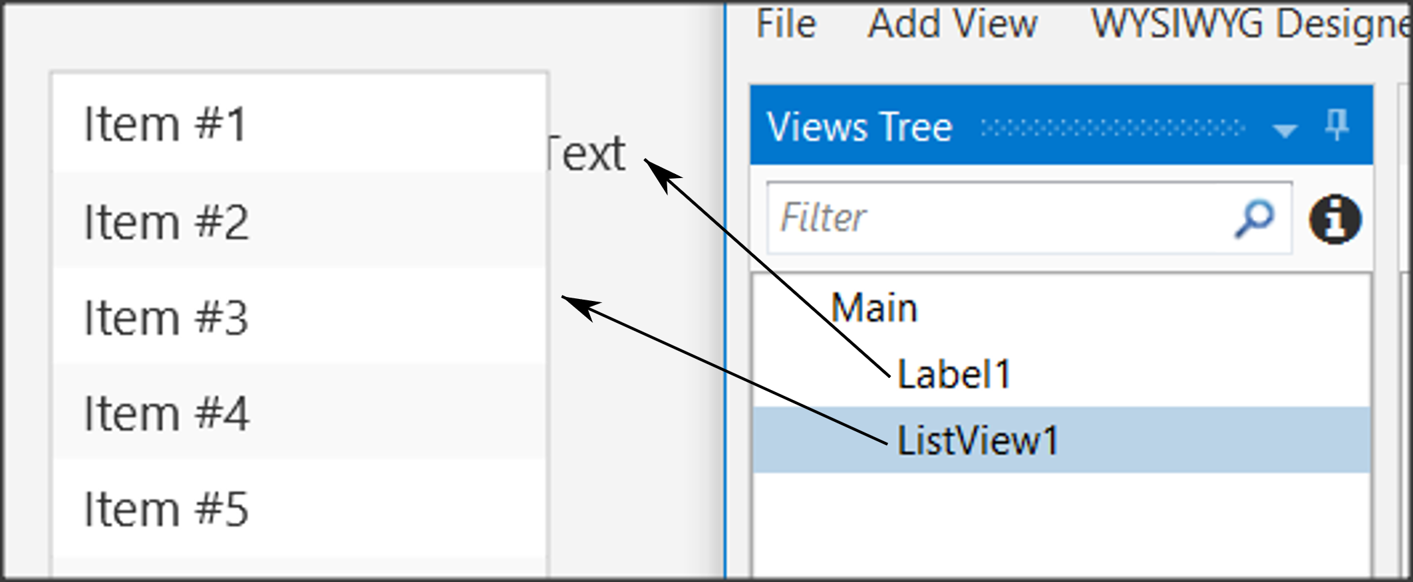
The Views Tree
Notes:
Here you see all the objects in your design. Keep in mind that the objects above the list are placed behind the next ones.

Slide 8

Properties
Type | Prefix | Example
Label | lbl | lblName
Button | btn | btnSave
TextField | txt | txtAge
Spinner | spn | spnYears
Pane | pn | pnLine1
Notes:
Each object has properties such as size, screen position, colors, font, etc. Each property can be changed either through the properties option or later through the program code.
One of the most important properties is the name of the object. This, like variables, should follow specific rules to indicate their type. For example, in the table (table 3 naming objects ) you see some cases of names.

Slide 9
Abstract Designer
The Abstract Designer allows to select position and resize Views.
Notes:
The Abstract Designer allows to select position and resize Views. It is a very useful function for quickly placing objects in the correct position (however the most accurate placement is made by the Properties tab by setting the relevant values).

Slide 10

Example
Imagine that you want to make a program that reads from the screen two Integers, calculates, and shows the sum.
Data | Information
intFirstNumber | intSum
intSecondNumber

Slide 11
Example - Decide on the size of the app screen.
Imagine that you want to make a program that reads from the screen two Integers, calculates, and shows the sum.
#Region Project Attributes
#MainFormWidth: 600
#MainFormHeight: 400
#End Region
Save your project and open Designer.
Notes:
This depends on the amount of information we must display as well as on the individual items such as menus, graphics etc.
To set the application’s size before beginning the Designer first go to Main Tab and change the first lines of code Width and Height:

Slide 12
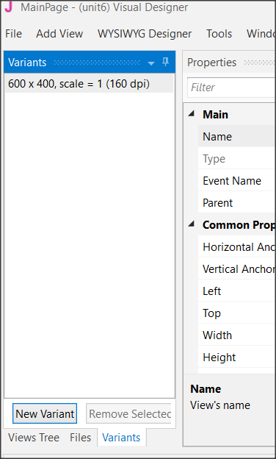
Example - Set an appropriate variant.
Imagine that you want to make a program that reads from the screen two Integers, calculates, and shows the sum.
Set the variant as the
MainFormWidth
and
MainFormHeight.
Notes:
This will help you plan without the risk of going outside the screen limits.
Choose Variants and then New Variant and set the width and height.
You can have as many variants as you want for different screen size but for now, we stay to only one. Also, you can remove any variant by selecting it and choosing “Remove Variant”.

Slide 13
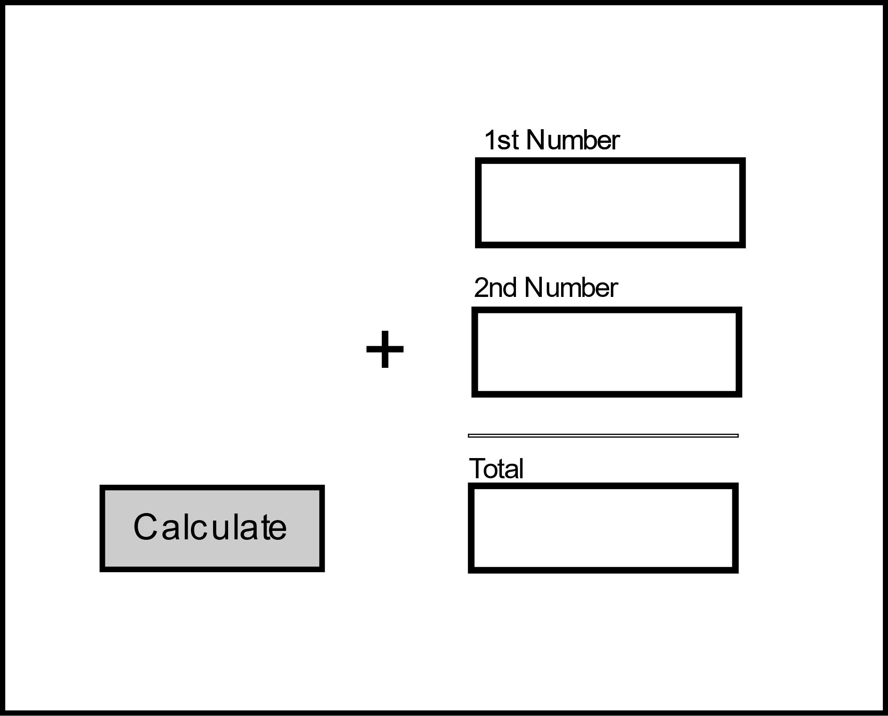
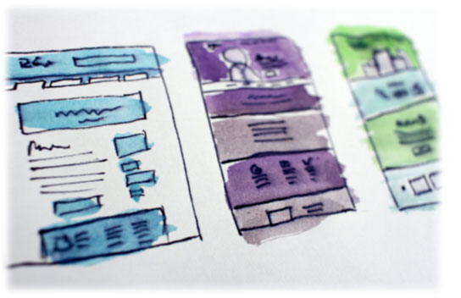
Example - Design a wireframe.
Imagine that you want to make a program that reads from the screen two Integers, calculates, and shows the sum.
Wireframe: Imagine how you want your application look like and sketch it on a paper or use a sketch program instead.
Label 1
Lebel 2
Label 4
Pane
Label 3
Button 1
textField 1
textField 2
textField 3
Notes:
For small applications, this step is optional, but it is a good habit to have decided from the beginning where you want to display your details. You can use a simple sheet of paper or several programs to help create previews.

Slide 14
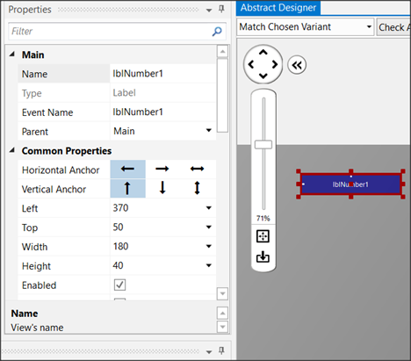
Create the views - Labels
Imagine that you want to make a program that reads from the screen two Integers, calculates, and shows the sum.
View menu label
Properties:
Name: lblNumber1
Width: 180
Height: 30
Text: First Number
Allignment: CENTER_LEFT
Font: SansSerif
Size: 13
Notes:
From View menu select label and you will see a label object in your View Tree and in the Abstract Designer. Move it in the place you decide in wireframing and choose an appropriate name from properties.
Experiment with the other settings and see it displayed in the preview pane.
Insert a second label or you can also dublicate the first one. Select it and press Ctrl-D. The second method gives a same label as the first one with the same properties except Name Property. Set “lblNumber2” as name and “Second Number” as Text and Create a third label with name “lblTotal” and Text: “Total”.

Slide 15
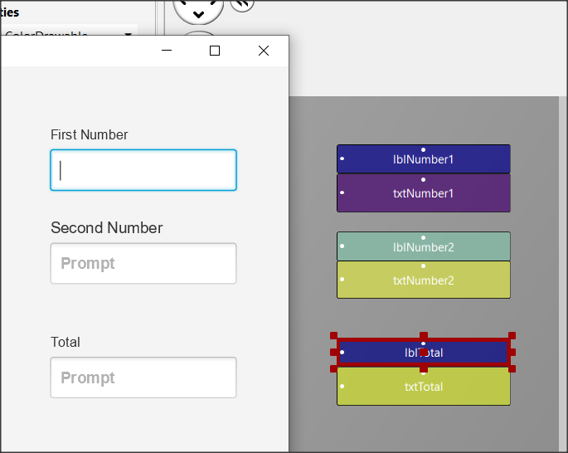
Inserting a Text Field.
Imagine that you want to make a program that reads from the screen two Integers, calculates, and shows the sum.
Text Fields are used to import data into the program.
From View TextField
Name: txtNumber1
Width: 180
Height: 40
Font: SansSerif
Bold: checked
Notes:
Try to design this

Slide 16
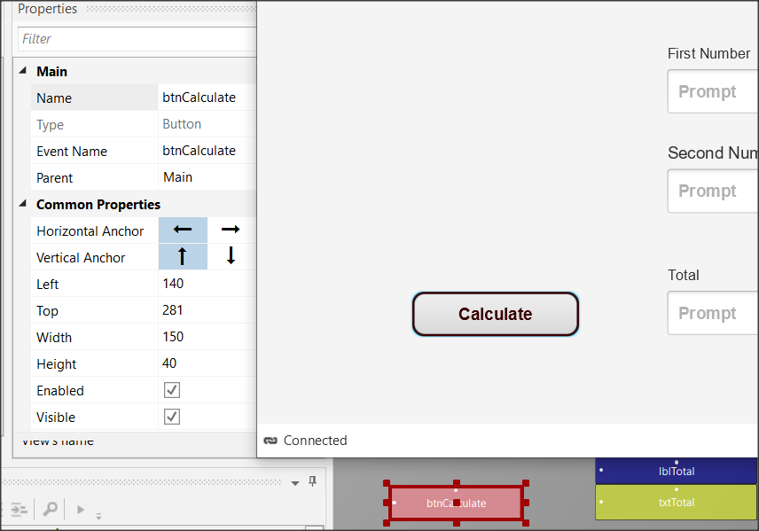
Buttons
Imagine that you want to make a program that reads from the screen two Integers, calculates, and shows the sum.
Name: btnCalculate
Width: 150
Height: 40
Border Color: #3C0000
Border Width: 2
Corner Radius: 20
Text: Calculate
Text Color: #FF3C0000
Font: SansSerif
Size: 15
Bold: checked
Notes:
Buttons in an app are used to enable functions.
The program detects the click and then executes appropriate commands depending on the button pressed.
For each button you can set different features such as size, color, shape, etc. to stand out on your screen and be easily detected by users of your app.

Slide 17
Save – Save – Save
File -> Save
(or Ctrl – S) every time you make something valuable!

Slide 18
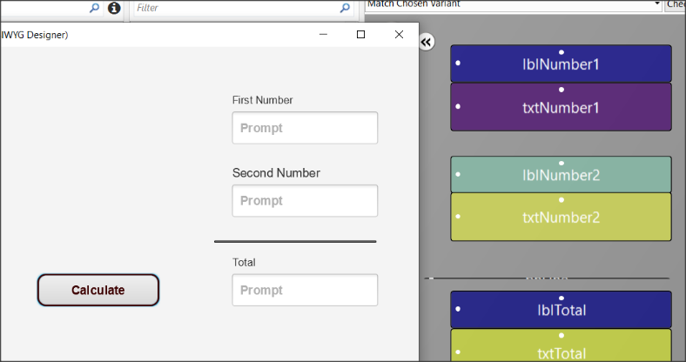
Inserting a Pane
Imagine that you want to make a program that reads from the screen two Integers, calculates, and shows the sum.
Name: pnLine
Width: 180
Height: 1
Border Color: #000000
Border Width: 2
Notes:
You can use a Pane to visually group specific objects on the screen you're drawing. The pane displays a frame, and you can specify properties such as color, border, fill, etc. You can also use it at a very small height (1 or 2) to display a single line on your screen.
This example is used to draw a line before the total.

Slide 19

Short break

Slide 20
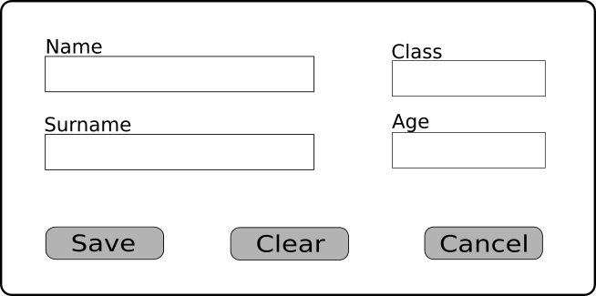
Exercise 1

Slide 21
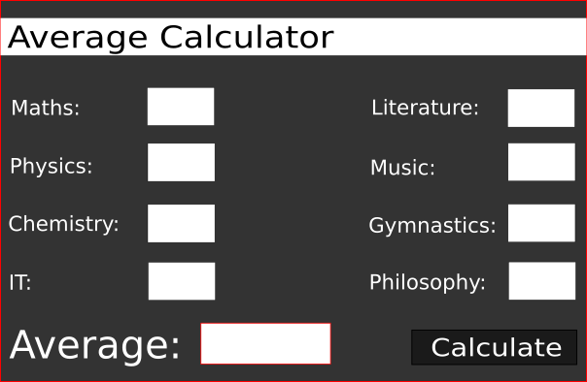
Exercise 2

Slide 22
Thank you!!!
Photos taken From:
Photo by HalGatewood.com on Unsplash

